Slide 1
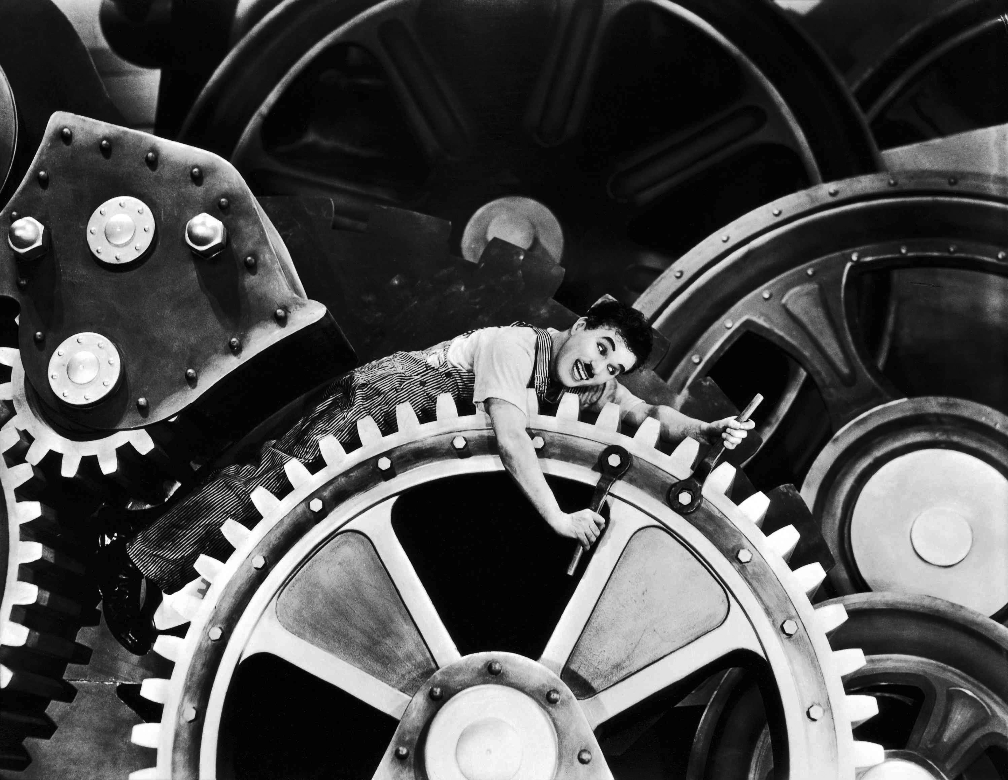

Simple Machines
14 - 4

Slide 2
Lesson Objectives
I can name, describe, and give an example of the six types of simple machines.
I can describe how to determine the ideal mechanical advantage of each type of simple machine.

Slide 3
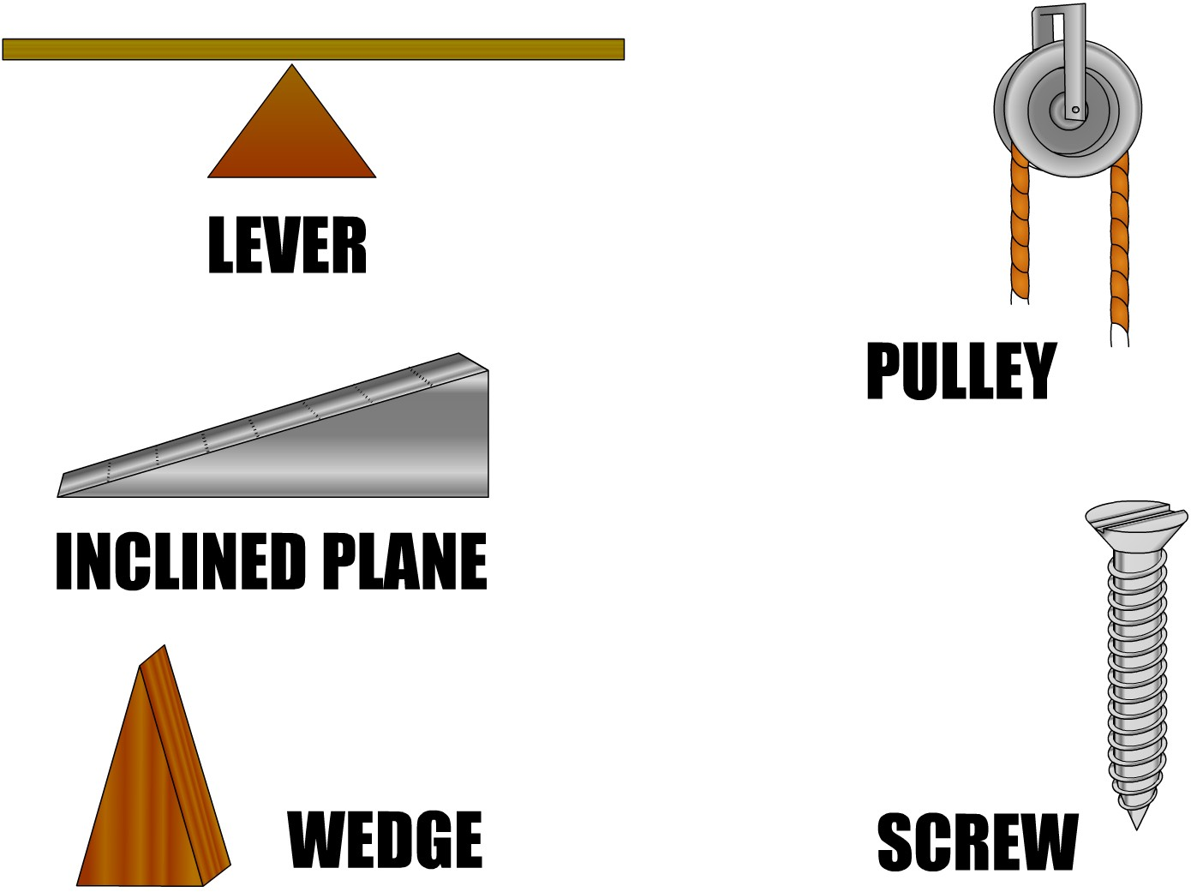
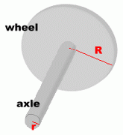
6 Different Types of Machines Homer could choose from:
Wheel & Axle

Slide 4
Input and Output
Machines involve two forces to accomplish work. Main Concept 4:
As a result of the Input force, an Output force occurs
and work gets done on an object!
Input Force (Effort Side)
Push or pull that you have to do to the machine
Example: Pushing keys on a keyboard
Person moves a shovel
Look for green to show the input in this slide show
Output Force (Result Side)
Push or pull the machine
does on the object
Example: What appears
on a computer screen
Shovel moves the dirt
Look for yellow to show
the output in this
slide show

Slide 5
The Lever
A bar that is free to pivot, or move about a fixed point called a fulcrum when an input force is applied.
Fulcrum = the pivot point of a lever.
There are three classes of levers based on the positioning of the effort force, resistance force, and fulcrum.

Slide 6

Lever
Input work (Effort Side)
Output work (Result Side)
Basically, this is a board that is placed on a pivot point called a fulcrum
Force
Force
As you apply a force to one side
the other side applies a force to the
object you want moved!
Here is the distance
needed

Slide 7
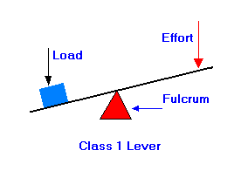
First Class Levers
Fulcrum is located between the input (effort) force and output (resistance) force.
Makes work easier by multiplying the effort force AND changing direction.
They will increase the force or distance depending on location of the fulcrum.
Examples: claw of hammer, rowing oars, seesaw

Slide 8
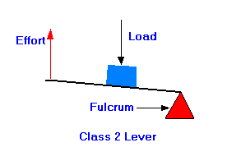
Second Class Levers
Output (resistance) force is found between the fulcrum and input (effort) force.
MA always greater than 1
Makes work easier by multiplying the effort force, but NOT changing direction.
Output force is greater than input force which causes the input force to be over a greater distance
Examples: bottle opener, wheelbarrow, nutcracker

Slide 9
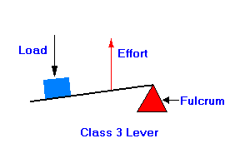
Third Class Levers
Input (Effort) force is located between the output (resistance) force and the fulcrum.
MA always less than 1
Does NOT multiply the effort force, only multiplies the distance.
Helpful because they increase the distance through which the output force is exerted.
Examples: Shovel, Tennis racket

Slide 10
Levers!!!!!!!!!!!

Slide 11
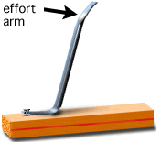
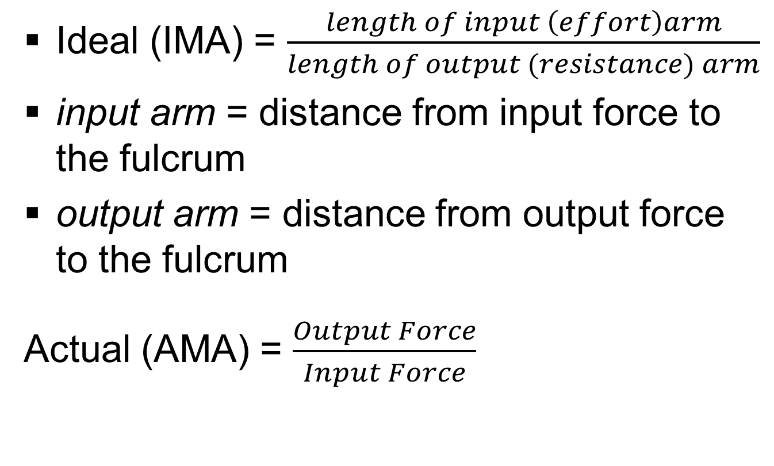
Mechanical Advantage
Levers
Ideal (IMA) = $\frac{length of input \left(effort\right)arm}{length of output (resistance) arm}$
input arm = distance from input force to the fulcrum
output arm = distance from output force to the fulcrum
Actual (AMA) = $\frac{Output Force}{Input Force}$

Slide 12
M. A. of Levers
Think: If the Input and Output are exactly
the same is there any point to using a machine?
Don’t forget: Work of Input = Work of Output
In this case, with the fulcrum right in the center, the forces,
distance and total input/output work are exactly the same!
Think: when force and
distance are exactly the
same; is there any M.A?
Force
Force
Distance
Distance
Work = Input Force x Input Distance Work = Output Force x Output Distance

Slide 13
So how can we increase M.A. of a lever?
We have to adjust how we set up the machine itself!
Notice that mathematically, even though the amounts of distance and force
have changed the total work done on both sides remains the same!
Notice what happens to
the force and distance of
each side when we move
Fulcrum closer to the mass
In this case we can move the fulcrum and change
the distance of the output and input:
Output: Less distance but more force!
Input: More distance but less force!
Force
Force
Distance
Distance
Work = Output Force x Output Distance
Work = Input Force x Input Distance

Slide 14

Inclined Planes
A slanted surface used to raise an object.
Make work easier because there is a smaller input force but must be done over a larger distance.
Examples: ramps, stairs, ladders

Slide 15

Incline Plane
An incline plane is a ramp that increases the distance needed to
move an object but makes the work easier to do.
Homer may have to push the box up,
but it takes less effort than simply lifting it
Where is the input and
output sides?
Input work (Effort Side)
Output work (Result Side)
Think: has the distance
required changed?
The work has been spread out over a greater distance than lifting straight up!
Therefore it is easier to accomplish (takes less effort)!

Slide 16

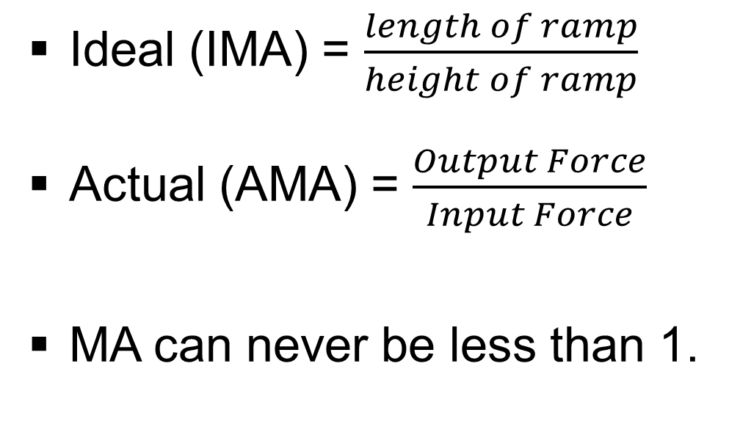
Mechanical Advantage
Inclined Planes
Ideal (IMA) = $\frac{length of ramp}{height of ramp}$
Actual (AMA) = $\frac{Output Force}{Input Force}$
MA can never be less than 1.
Ideal (IMA)

Slide 17
M.A. of an Incline Plane:
The same amount of work was accomplished with less force on your part!
The ramp is now
longer and less steep
Work that needs to
be accomplished
Distance
To give this simple machine more mechanical advantage, simply make the ramp longer
Notice: Did the height of the ramp change?

Slide 18
Wedges
A double inclined plane that moves or v shaped object whose sides are 2 inclined planes sloped towards each other
Increase MA by sharpening, make wedge longer, make wedge thinner
Examples: knife, axe, razor blade

Slide 19
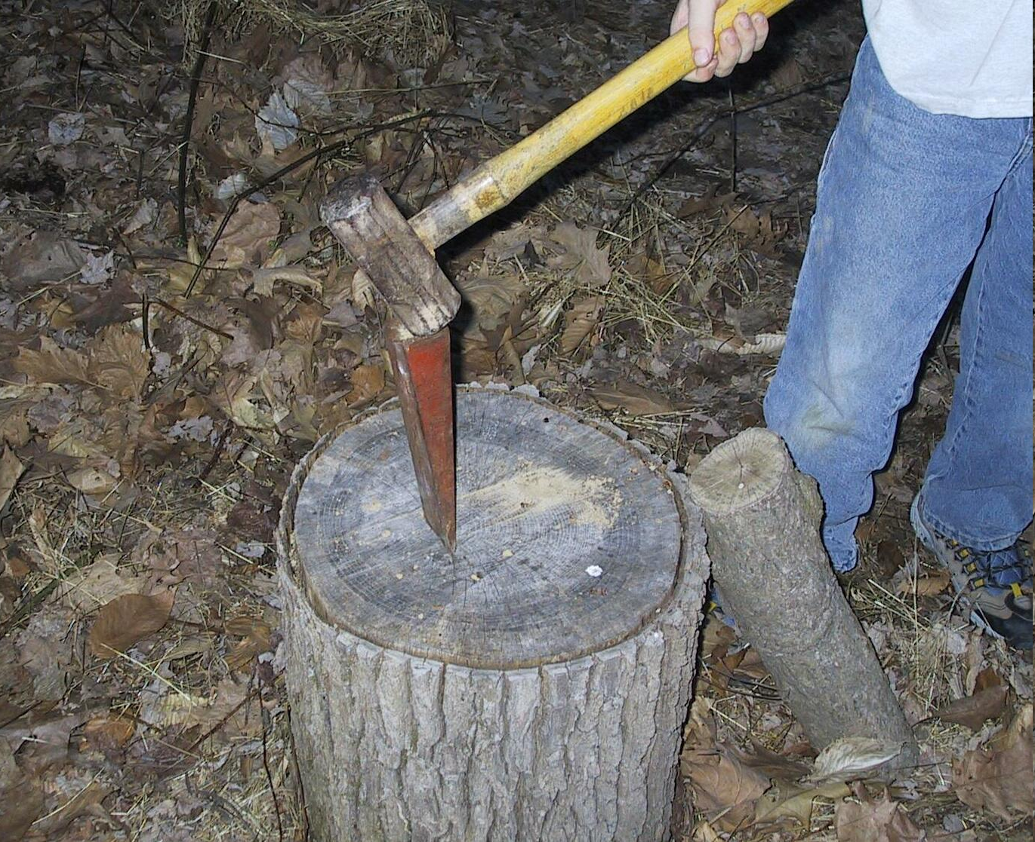
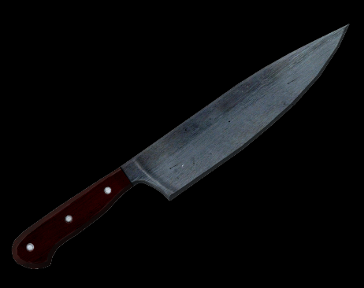
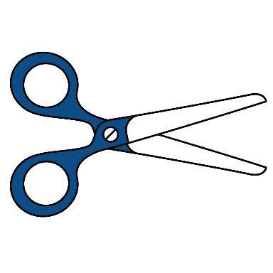
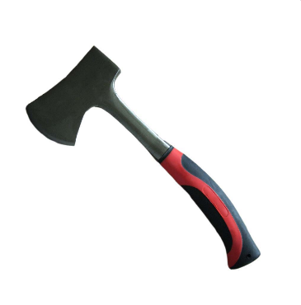
Wedge:
A wedge works like two
ramps put together.
Input Force
As the input force pushes down, the output force pushes out, splitting the object
Output Force

Slide 20
Screws
An inclined plane wrapped around a cylinder.
Examples: bolts, augers, drill bits

Slide 21
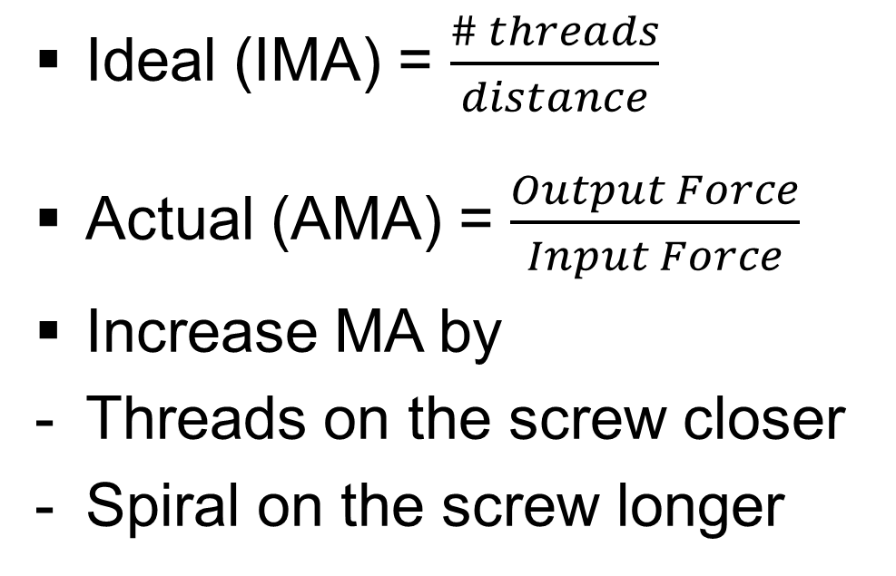
Mechanical Advantage
Screws
Ideal (IMA) = $\frac{\# threads}{distance}$
Actual (AMA) = $\frac{Output Force}{Input Force}$
Increase MA by
Threads on the screw closer
Spiral on the screw longer

Slide 22

Wheel and Axle
A lever that rotates in a circle.
A machine consisting of a combination of two disks or cylinders (wheels) of different sizes (radius).
Smaller wheel is termed the axle.
Examples – Doorknobs, ferris wheels

Slide 23
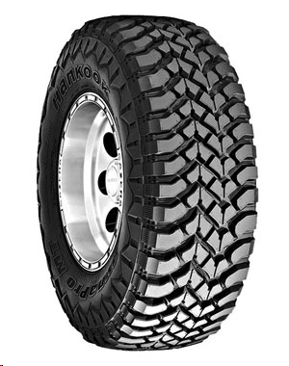
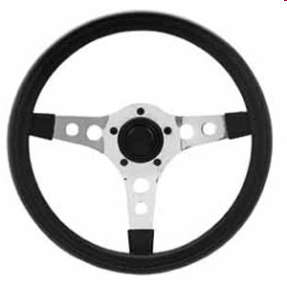
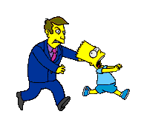
The Wheel & Axle
The input and output of a wheel and axel
will all depend on how you use it.
If it is used as steering wheel to turn (or something like it)
Then the Input comes through the wheel and the output is from
the axel
If it is used as a wheel to move a car (or something like it)
Then the input comes through the axel and the output is from the turning of the wheel
Either the axel turns the wheel or
the wheel turns the axel.
Q: How could Homer use a wheel
and axle to lift his box?

Slide 24
Homer turns the crank on the wheel and the box on the ramp moves up
Don’t forget!
This is the work Homer
Is trying to do!
= Lift the box this distance
Now you would have to ask when a machine this size
would be worth the effort to make it
Maybe if there were a lot of boxes
to lift = more work to do

Slide 25
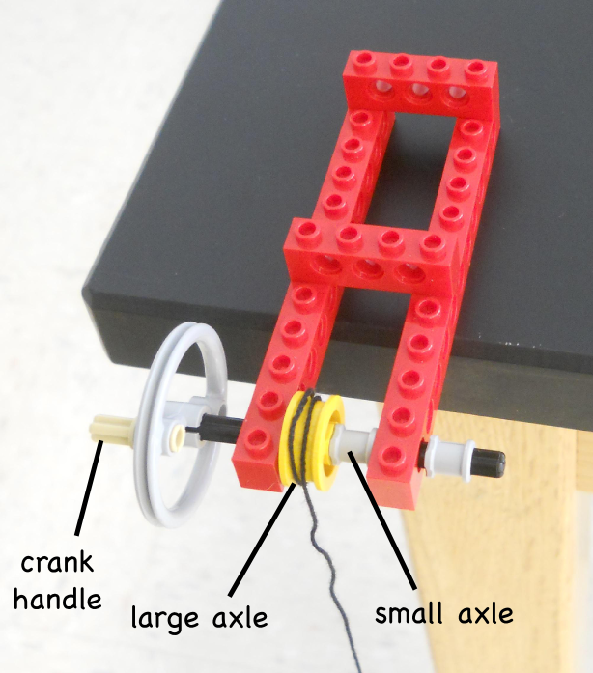
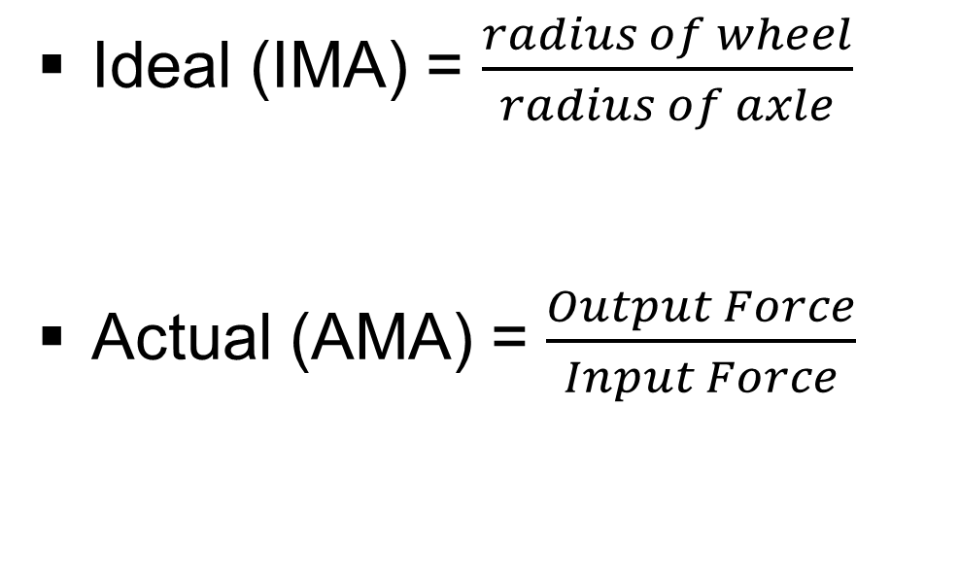
Mechanical Advantage
Wheel and Axle
Ideal (IMA) = $\frac{radius of wheel}{radius of axle}$
Actual (AMA) = $\frac{Output Force}{Input Force}$

Slide 26
Pulleys
A chain, belt , or rope wrapped around a wheel.
Can either change the direction or the amount of effort force
Ex. Flag pole, blinds, stage curtain

Slide 27
Pulley Types
FIXED
Can only change the direction of a force.
Does not increase the force and is attached to something that does not move
MA = 1
MOVABLE
Can multiply an effort force, but cannot change direction
Causes input force over a greater distance.
Attached to the object being moved
MA = 2
Block and Tackle
Fixed pulley and movable pulley used together.
Can have large MA if several pulleys used together.
MA = > 2

Slide 28
Pulleys
Which side of the pulley is the
input and which is the output?
When you apply a pull force to one side
of the rope, the rope applies a pull
force to the object side
and the object gets lifted
A pulley is a wheel with a rope wrapped
around it and attached to the object
you want to move.
Force
Input Work (Effort Side)
Output (work side)
Force
Think: has the distance
required changed?

Slide 29
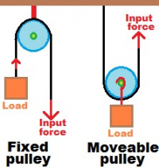
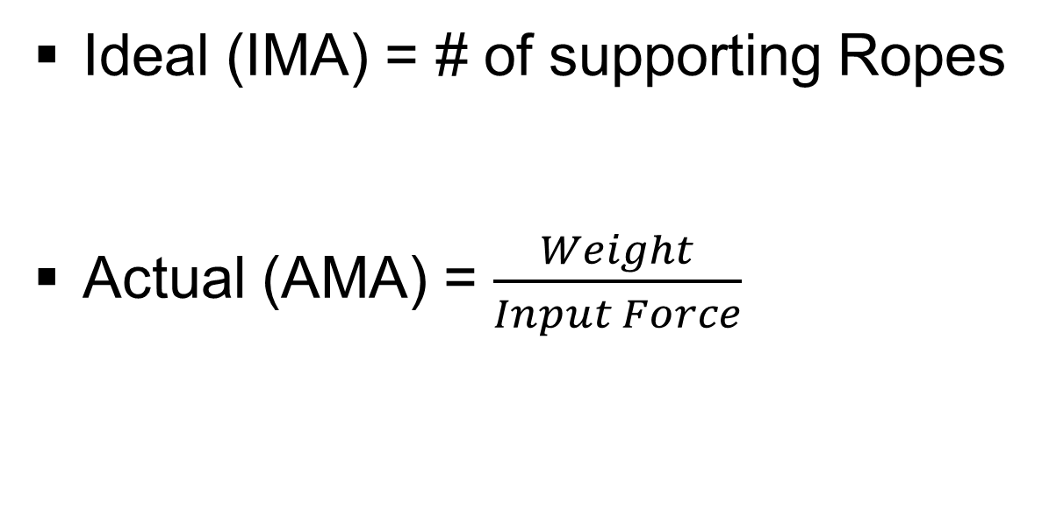
Mechanical Advantage
Pulleys
Ideal (IMA) = # of supporting Ropes
Actual (AMA) = $\frac{Weight}{Input Force}$

Slide 30
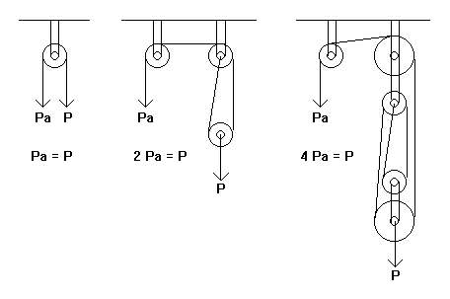
MA = Count # of ropes that apply an upward force (note the block and tackle!)

Slide 31
M.A. of Pulleys:
Notice that the force and
distance is equal
When you use a basic single pulley
setup, the M.A. = 1
Distance
Input Work (Effort Side)
Distance
In order to get M.A. you need to
change the distance of your input pull!
Output work side
Force
Force

Slide 32
Movable Pulleys give M.A.
Pulleys only have mechanical advantage when you use a moveable pulley with your setup.
Input (Effort Side)
Force
Output (Resultant Side)
Distance
Work = Force x Distance
Watch the difference in distance for
Input and the Output!
Notice that you have to pull more rope to
accomplish the same output distance.
Force
Distance
This is the point! More Input distance will lessen
then amount of Input force needed!
Work = Force x Distance
When you increase the Input distance, the Input force automatically goes down and the Output force automatically goes up!!!

Slide 33
Movable + Fixed Pulley
Combination (“Block and Tackle”)
Fixed Pulley
Pulleys only have mechanical advantage when you use a moveable pulley with your setup.
Output Force (Result)
Input Force (Effort)
Moveable Pulley
By making a combination of Pulleys, we are adding
even more input distance, which should lower out
Input force even more = more M.A.!!!

Slide 34
Compound Machines
A combination of two or more simple machines.
Cannot get more work out of a compound machine than is put in.
Usually have a low MA because the more moving parts the more friction

Slide 35
Compound Machine
The use of a wheel and axle are actually very common
The rear wheel turns more for each time you
pedal causing you to travel farther with less force
Slow
Fast

Slide 36
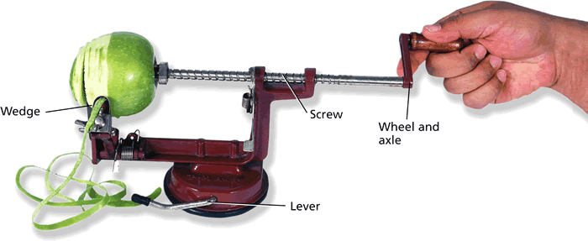
“Compound Machine”
Any combination of several simple machines…
A compound machine is simply two or more simple machines put together.
Notice that there are at least 4 different
simple machines in this one compound machine
Simple machines are most often used
in combinations like this!

Slide 37
Big Ideas
A compound machine is a combination of 2 or more simple machines.

